Slide 1
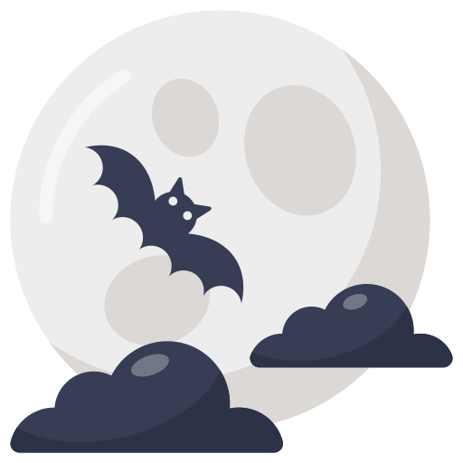
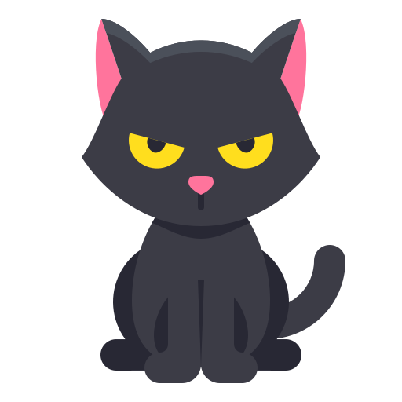
Vocabulary
Halloween story
Trick or treat
Trivia

Slide 2
Vocabulary
Halloween story
Trick or treat
Trivia

Slide 3
Vocabulary
Halloween story
Trick or treat
Trivia

Slide 4
Vocabulary
Halloween story
Trick or treat
Trivia

Slide 5
Vocabulary
Halloween story
Trick or treat
Trivia

