Slide 2
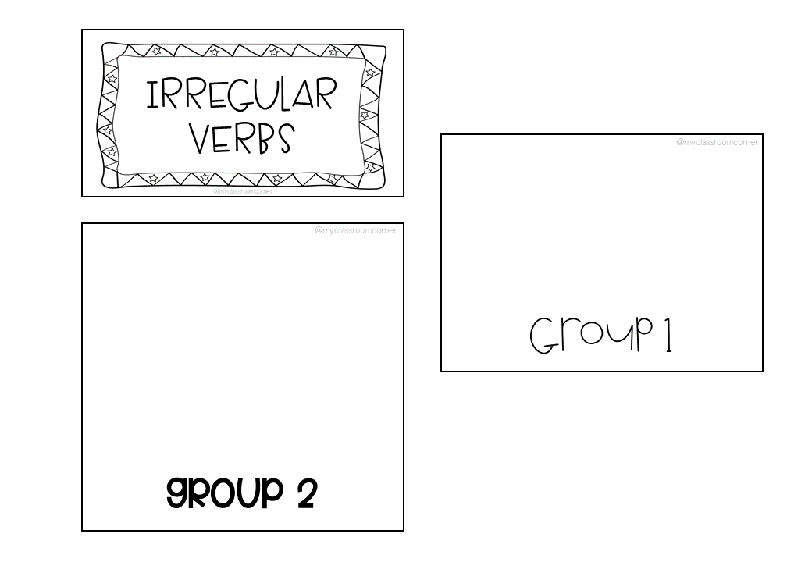
INFINITIVE | PAST | PARTICIPLE | MEANING
INFINITIVE | PAST | PARTICIPLE | MEANING

Slide 3
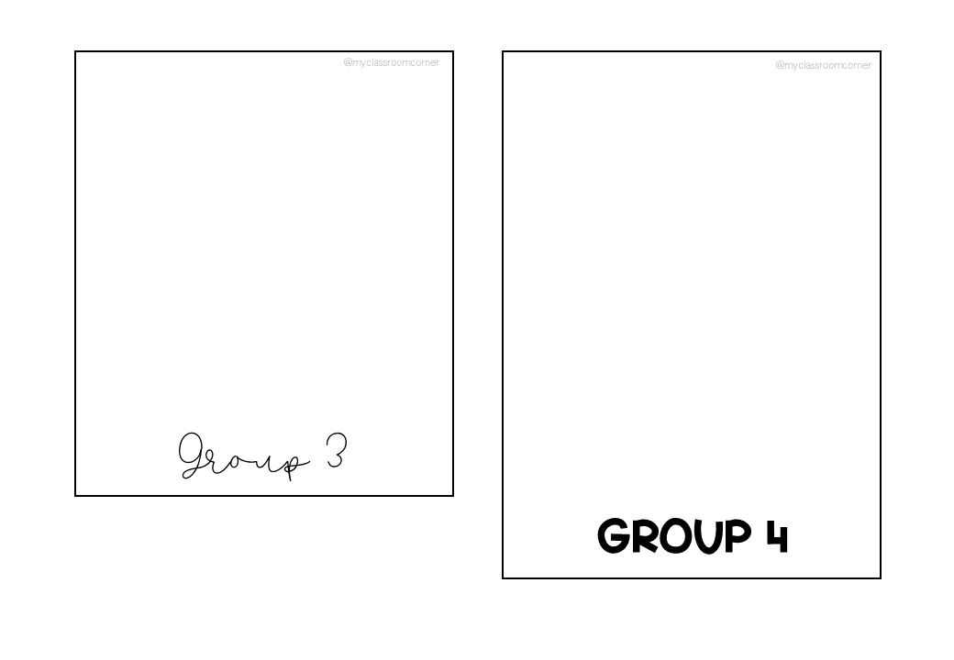
INFINITIVE | PAST | PARTICIPLE | MEANING
INFINITIVE | PAST | PARTICIPLE | MEANING

Slide 4
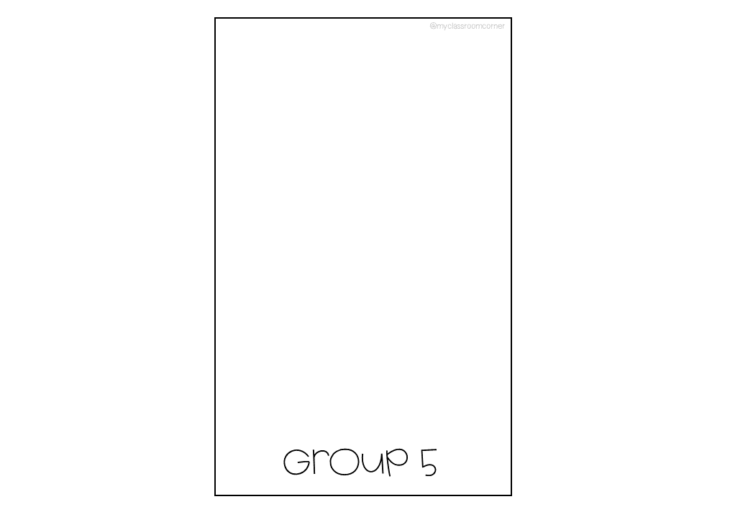
INFINITIVE | PAST | PARTICIPLE | MEANING

