Slide 1
SPORTS QUIZ

Slide 2
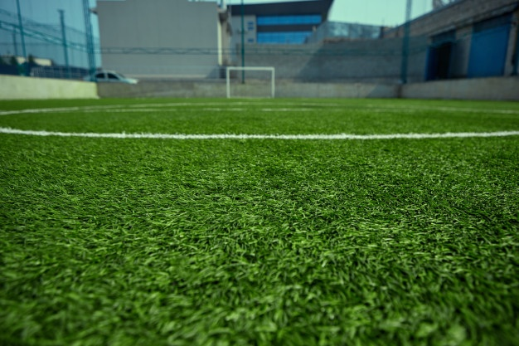
WHERE DO YOU PLAY FOOTBALL?
PITCH
COURT
COURSE

Slide 3
WHICH OF THESE SPORTS ARE PLAYED IN A RING?
JUDO
KARATE
BOXING

