Slide 1
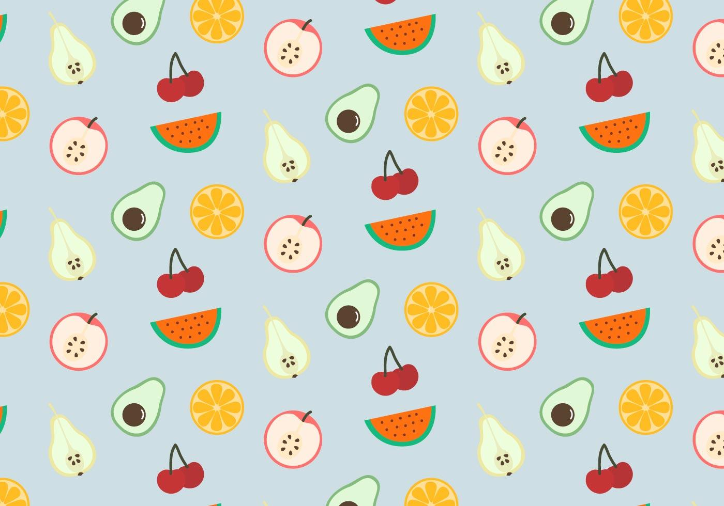
Hello Teacher Ana
FOOD
FOOD
6X6
Spelling / Speaking game
Follow me on Instagram:
@hello.teacher.ana

Slide 2
Hello Teacher Ana
FOOD
6X6 Spelling / Speaking game
En este documento encontrarás:
Juego tablero 6x6 Speaking game o Spelling game.
Tableros de vocabulario.
Se recomienda el uso combinado con el resto de recursos que puedes encontrar gratuitamente en mi cuenta de Instagram.
Sígueme en:
@hello.teacher.ana
@hello.teacher.ana © 2021 by Ana María Marín Laporta is licensed under CC BY-NC-ND 4.0.

Slide 3
Hello Teacher Ana
FOOD
FOOD
Speaking – spelling game
Pósters de vocabulario, que se pueden imprimir en A4, A5 o A6 para montar en forma de minilibro.
@hello.teacher.ana

Slide 4
FOOD
Hello Teacher Ana
A
B
C
D
E
F
1
Team 1
2
0
1
2
3
4
5
6
7
8
9
10
11
12
13
14
15
16
17
18
19
20
21
22
23
24
25
26
27
28
29
30
31
32
33
34
35
36
37
38
39
40
41
42
43
44
45
46
47
48
49
50
Team 2
3
0
1
2
3
4
5
6
7
8
9
10
11
12
13
14
15
16
17
18
19
20
21
22
23
24
25
26
27
28
29
30
31
32
33
34
35
36
37
38
39
40
41
42
43
44
45
46
47
48
49
50
4
Roll the dice
5
6
@hello.teacher.ana

Slide 5
FOOD
Hello Teacher Ana
Countable
BISCUITS
BURGER
HOT DOG
EGG
PANCAKES
SAUSAGE
SHRIMP
MUSHROOMS
CHIPS
CAKE
PIZZA
OLIVES
CHICKEN
SANDWICH
TACO
Hello Teacher Ana
@hello.teacher.ana

Slide 6
FOOD
Hello Teacher Ana
Uncountable
CHEESE
BREAD
BUTTER
JAM
CHOCOLATE
OLIVE OIL
FLOUR
MILK
SALAD
HAM
ICE CREAM
COFFEE
HONEY
LEMONADE
WATER
Hello Teacher Ana
@hello.teacher.ana

Slide 7
FOOD
Hello Teacher Ana
Uncountable
ORANGE JUICE
SUGAR
PASTA
RICE
FISH
MEAT
PAELLA
SEAFOOD
HEALTHY FOOD
FAST
FOOD
Hello Teacher Ana
@hello.teacher.ana

Slide 8
Hello Teacher Ana
FOOD
6X6 Spelling / Speaking game
TÉRMINOS Y CONDICIONES DE USO
Iconos
y fuentes
Está permitido:
Usar este recurso en tus clases y como uso personal.
Compartirlo en las redes mencionándome.
No está permitido:
Comercializar/promocionar como tuyo.
quitar mi logo.
Sígueme en:
@hello.teacher.ana
@hello.teacher.ana © 2021 by Ana María Marín Laporta is licensed under CC BY-NC-ND 4.0.

Slide 9
Hello Teacher Ana
ENJOY IT!
ENJOY IT!
Follow me on Instagram:
@hello.teacher.ana

