Slide 2
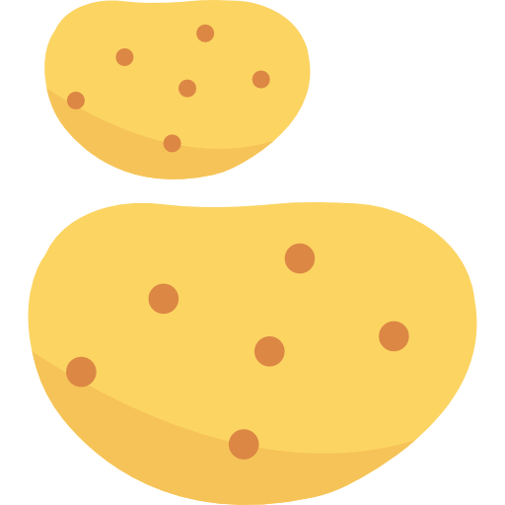
Which of these foods is a fruit?

Slide 3
Which of these foods has more than one element?

Slide 4
Which of these foods is a vegetable?

Slide 5
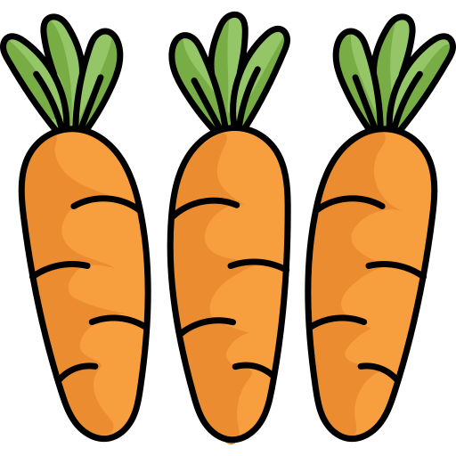
Which of these foods is
not a plant?

