Slide 1
Vocabulary

Slide 2
Leave the correct landscape

Slide 3
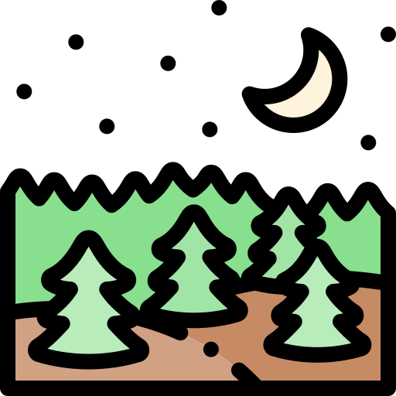
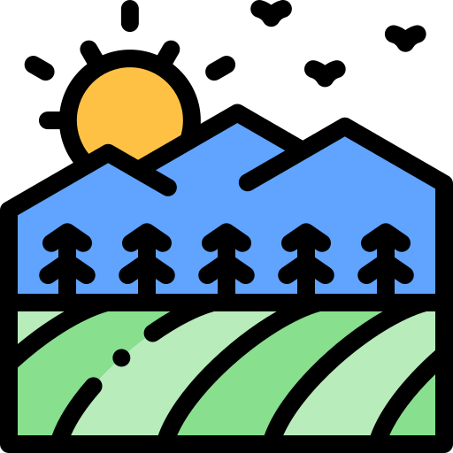
beach

Slide 4
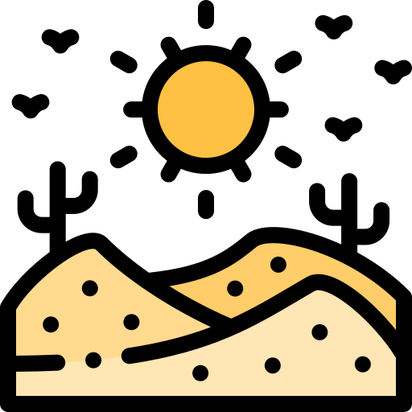
desert

Slide 5
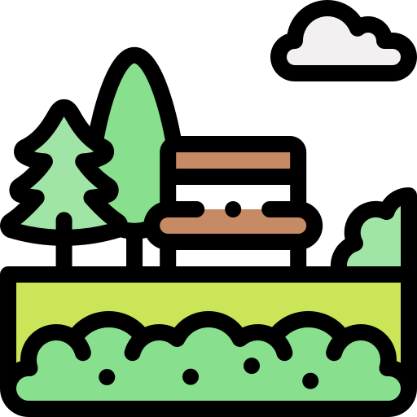
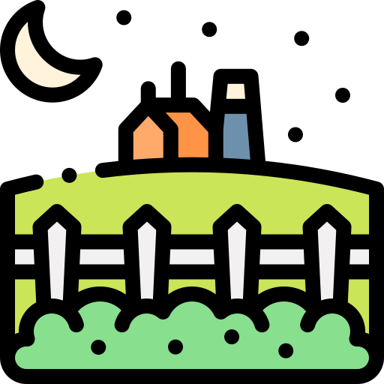
island

Slide 6
rainbow

Slide 7
mountain

Slide 8
forest

Slide 9
waterfall

Slide 10
city

Slide 11
jungle

Slide 12
THANKS

