Slide 1
SAY THE CORRECT ANSWER.
Click on the correct bitmoji

Slide 2
Have you got a bookcase in your bedroom?
Yes, it is
Yes, I have
Yes, it have
Yes, I is

Slide 3
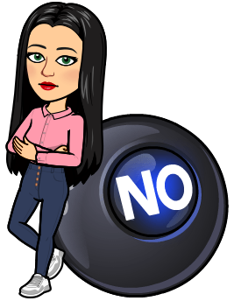
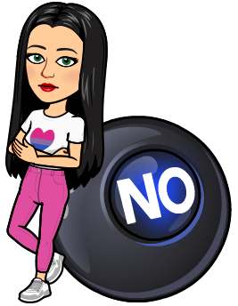
Have you got a plant in your bedroom?
No, it isn’t
No, I have
No, it haven’t
No, I haven’t

Slide 4
Have you got a computer in your bedroom?
No, I have
No, it haven’t
No, I haven’t
No, it is

Slide 5
Have you got a desk in your bedroom?
Yes, it is
Yes, I have
Yes, I haven’t
Yes, I is

Slide 6
Have you got a rug in your bedroom?
No, I isn’t
No, I haven’t
No, it haven’t
No, it is

Slide 7
Have you got a cushion in your bedroom?
Yes, I have
Yes, I is
Yes, I isn’t
Yes, it is

Slide 8
Have you got a picture in your bedroom?
No, I haven’t
No, it is
No, I isn’t
No, it haven’t

Slide 9
Have you got a wardrobe in your bedroom?
Yes, I is
Yes, I isn’t
Yes, it is
Yes, I have

