Slide 1
Click the circle…

Slide 2
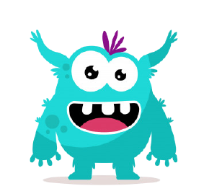
I AM A PINK MONSTER!

Slide 3
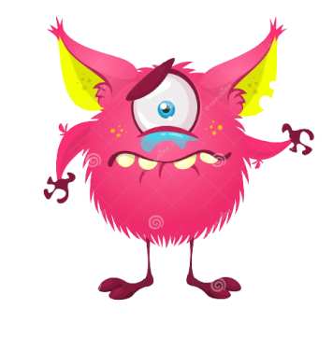
I AM A SAD MONSTER!

Slide 4
I AM NUMBER TWO!
2
1
3

