Slide 1
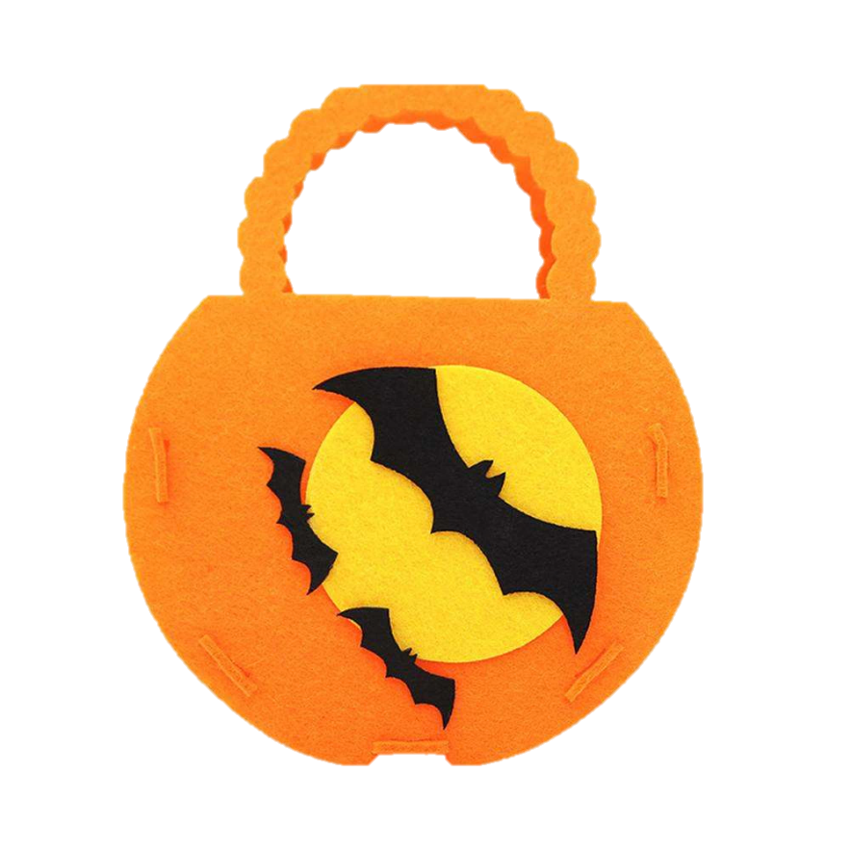
Halloween’s secret numbers
8
5
0
3
7
1
4
2
9
6
@Kyoshi_in_Childhood

