Slide 1
HAPPY
HAPPY
SAD
SAD
ANGRY
ANGRY

Slide 2
SCARED
SCARED
SURPRISED
SURPRISED
TIRED
TIRED

Slide 3
HAPPY
SAD

Slide 4
ANGRY
SURPRISED

Slide 5
SCARED
TIRED

Slide 6
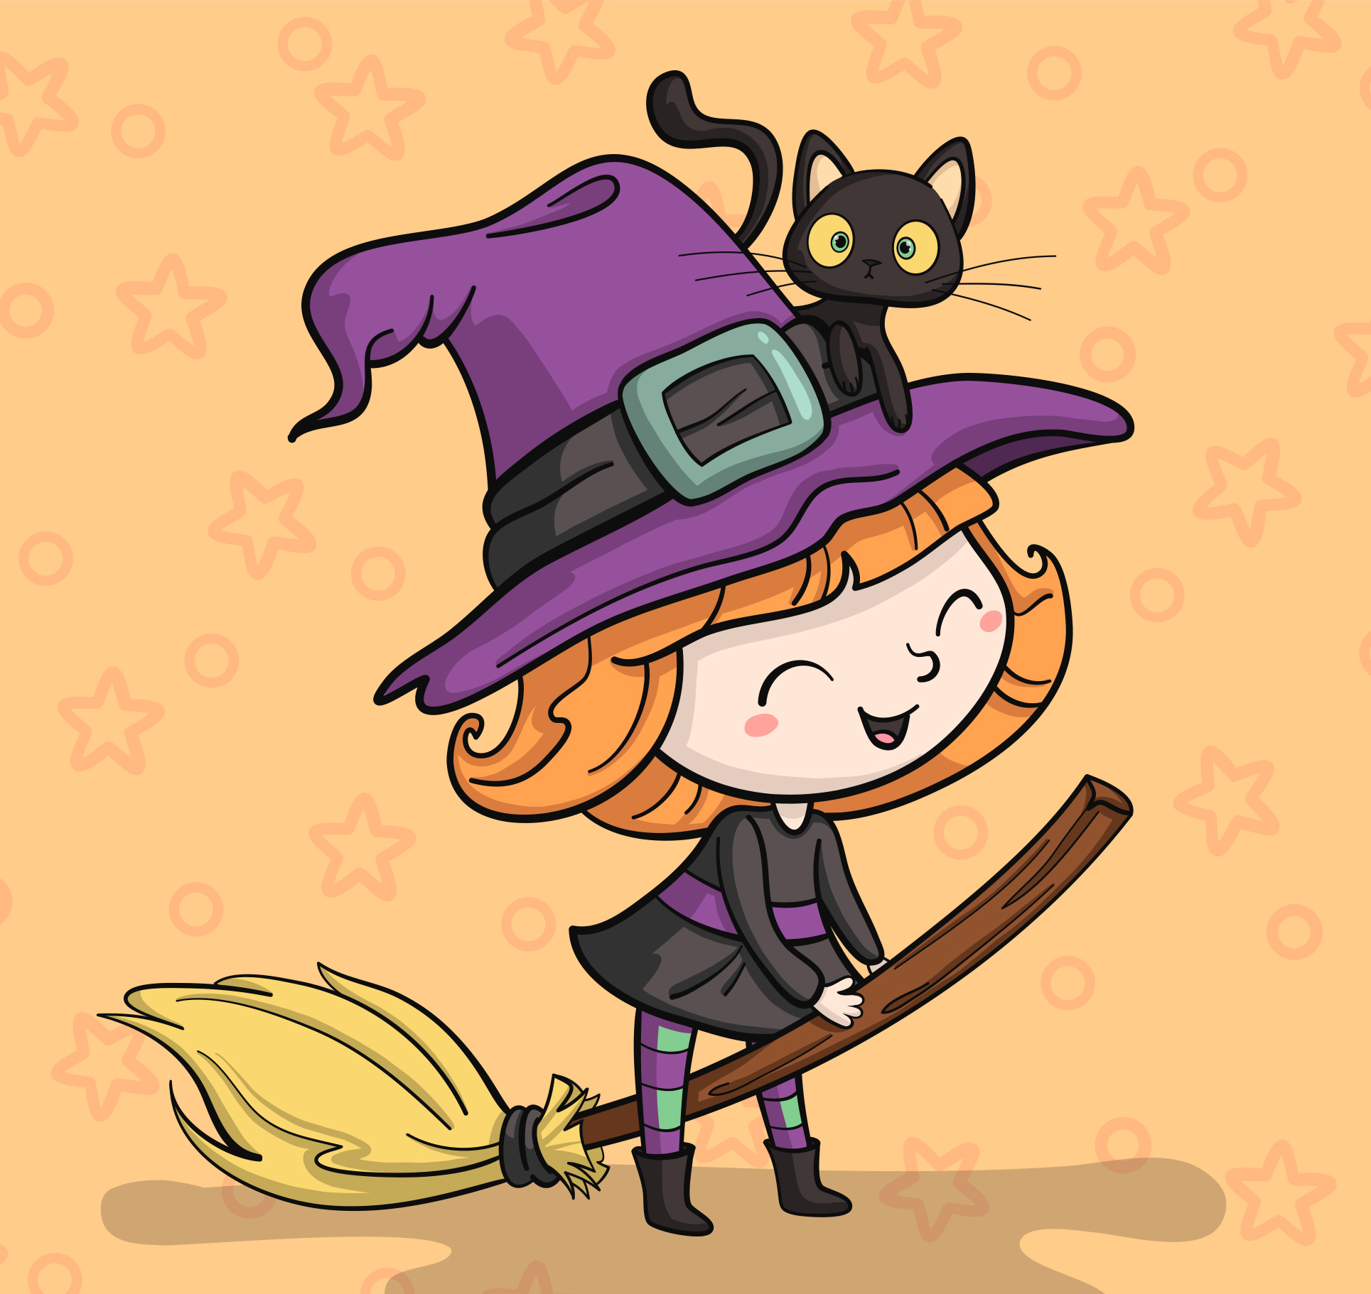
H
H
A
P
P
Y
H
H
A
P
P
Y

