Slide 1
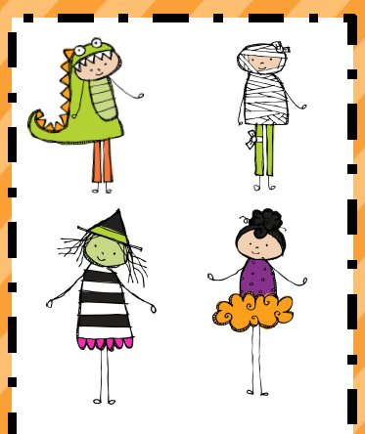
CAT
CAT
COSTUMES
PUMPKIN
PUMPKIN
COSTUMES
GHOST
GHOST
BAT
BAT

