Slide 1
HAPPY
HAPPY
SAD
SAD
ANGRY
ANGRY

Slide 2
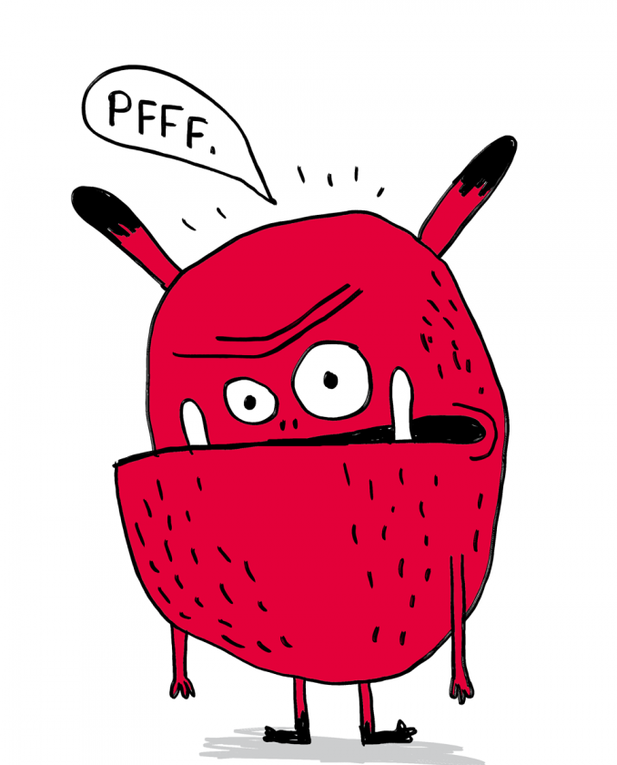
SURPRISED
GRUMPY
GRUMPY
SICK
SICK
SICK
SICK

Slide 3
HAPPY
ANGRY

Slide 4
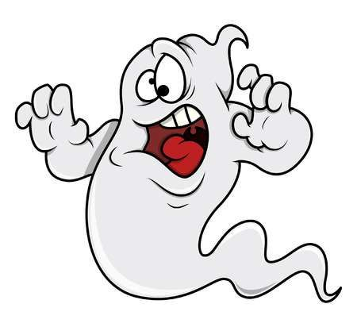
S
C
A
R
E
D

