Slide 1
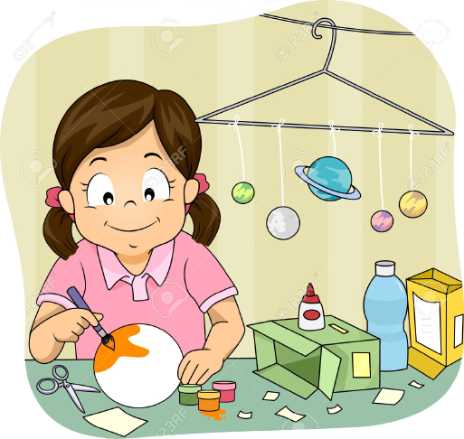
Make
models

Slide 2
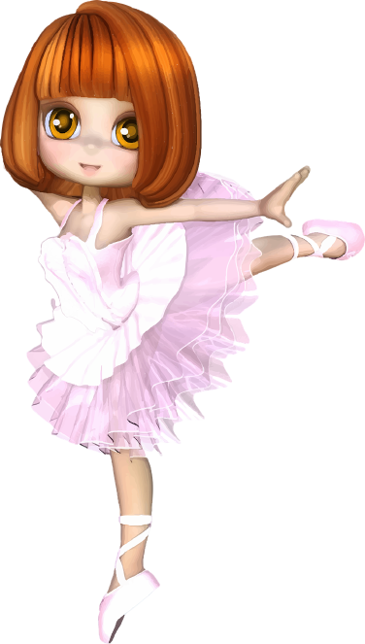
Dance

Slide 3
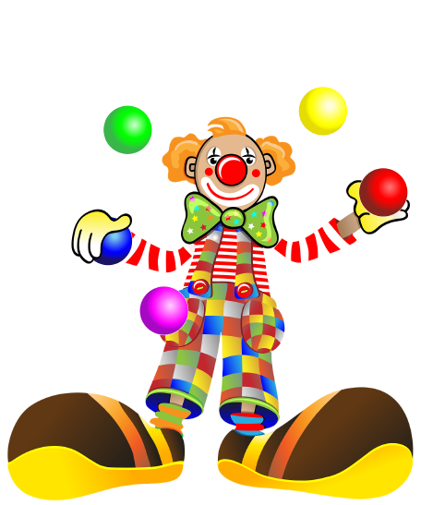
Juggle

Slide 4
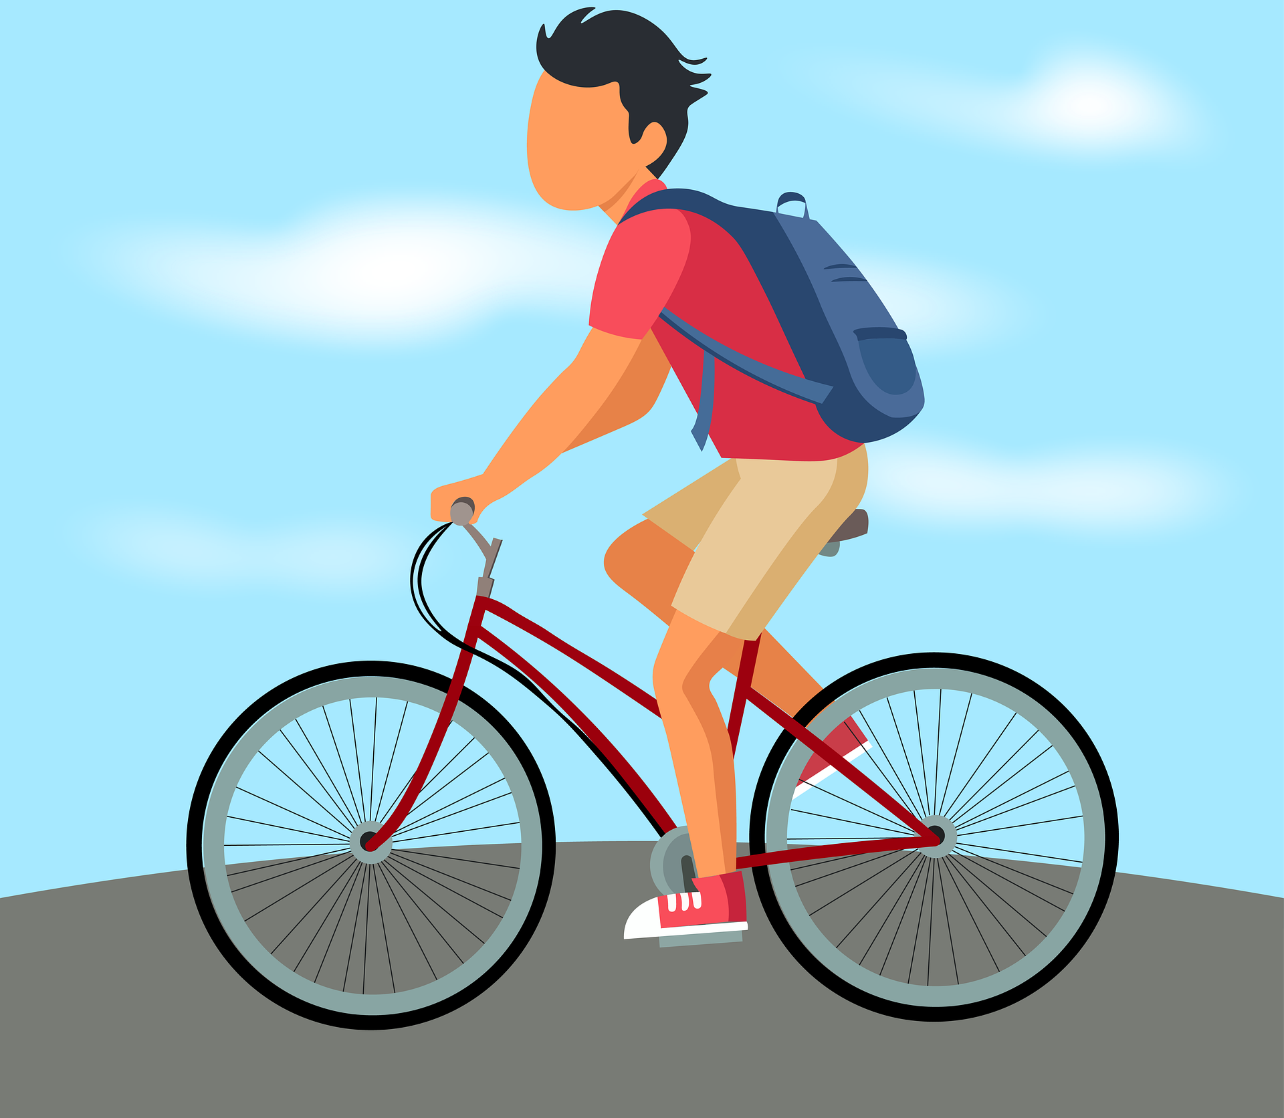
Ride
a
bike

Slide 5
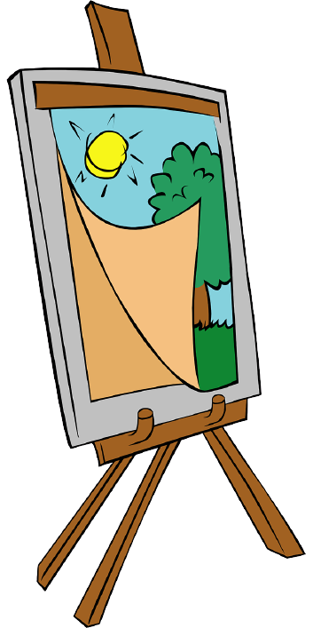
Paint

Slide 6
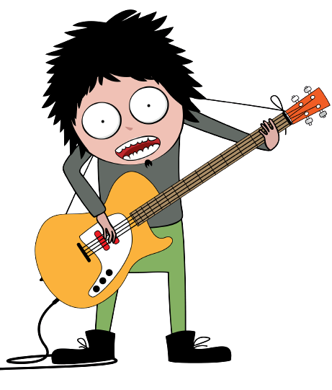
Play
the guitar

Slide 7
Do
karate

Slide 8
Sing

Slide 9
M
A
K
E
M
O
D
E
L
S

Slide 10
R
I
D
E
A
B
I
K
E

