Slide 1
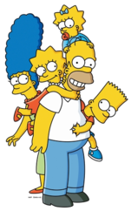
FOLLOW THE FAMILY WORDS
MOTHER
COUSIN
SON
CAT
DOG
COW
AUNT
UNCLE
HORSE
MOUSE
DUCK
NIECE
PIG
TURTLE
BIRD
NEPHEW
FATHER
GRANDFATHER
THEY ARE TOGETHER NOW!

Slide 2
START AGAIN

Slide 3
WELL DONE

