Slide 1
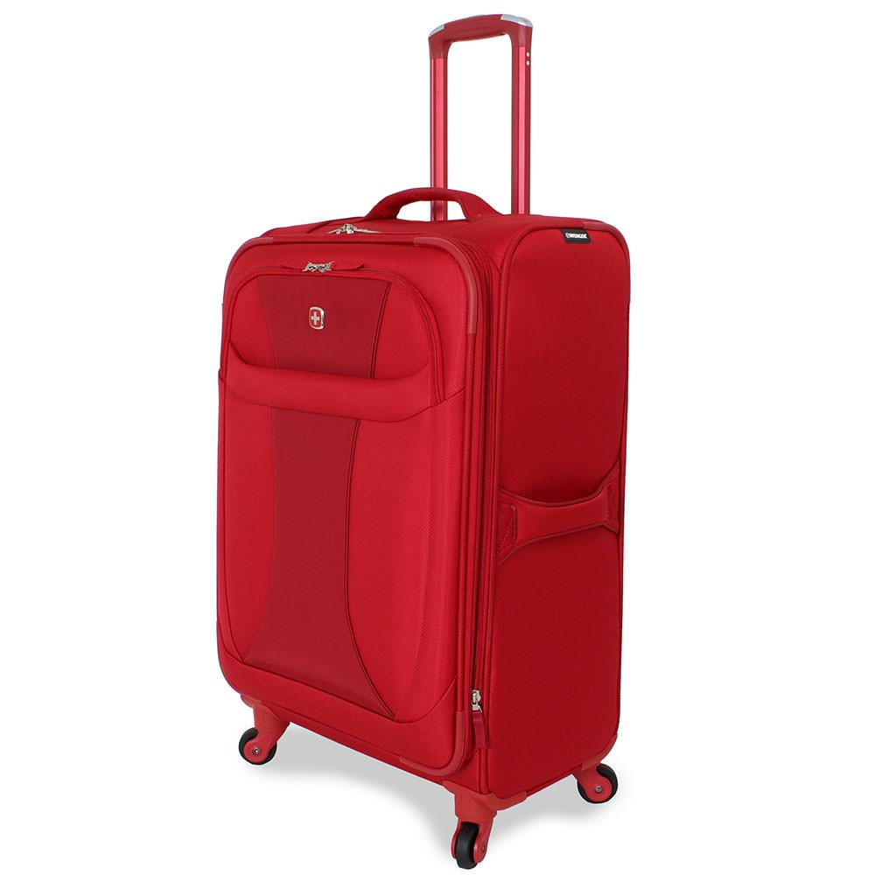
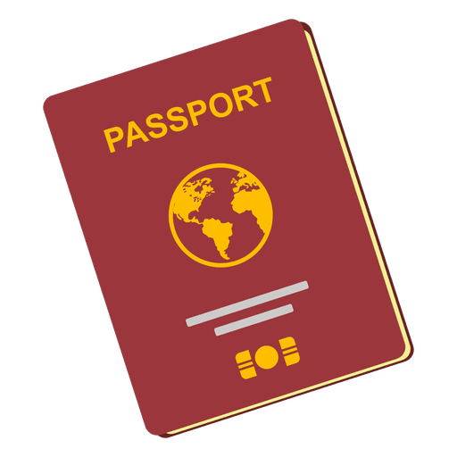
WHICH ONE IS TICKET
?

Slide 2
WHICH ONE IS PASSPORT
?

Slide 3
WHICH ONE IS BAGGAGE
?

Slide 4
WHICH ONE IS AIRPORT
?

