Slide 1
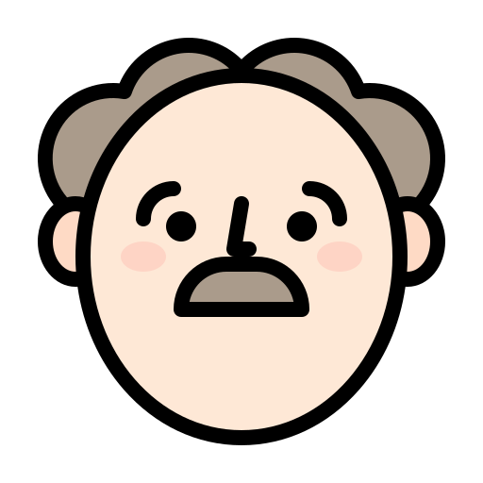
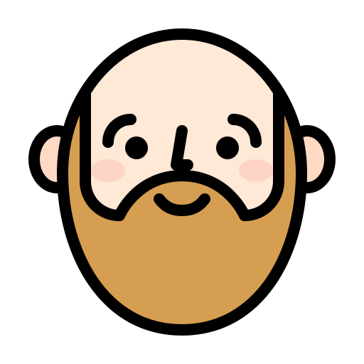
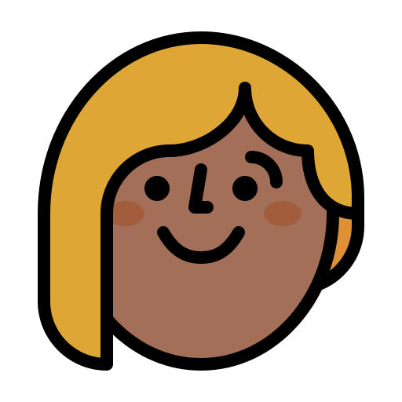
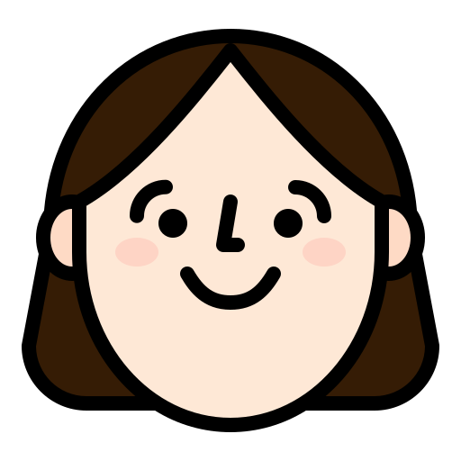
Who has grey hair?

Slide 2
Who has blonde hair?

Slide 3
Who has brown hair?

Slide 4
Who has ginger hair?

Slide 5
Who is bold?

