Slide 1
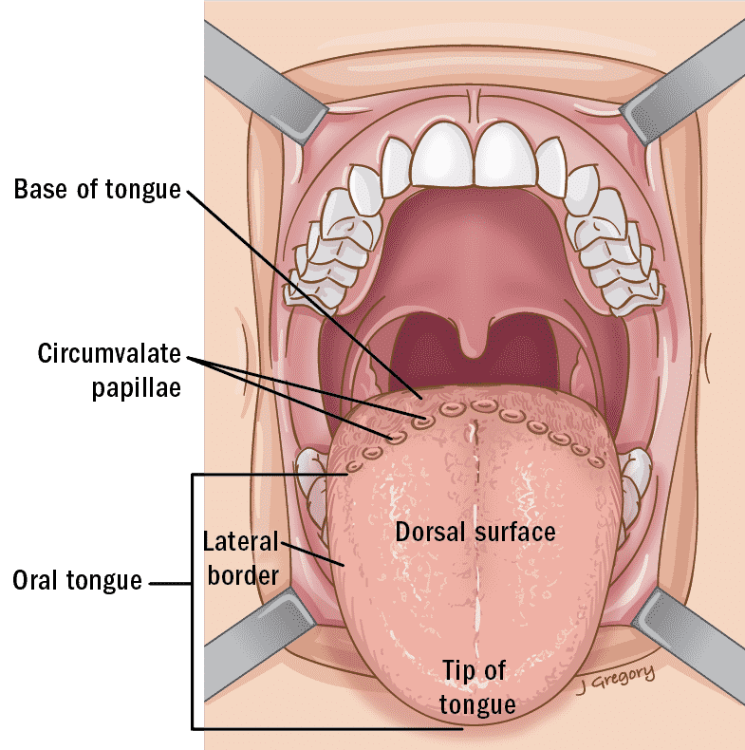
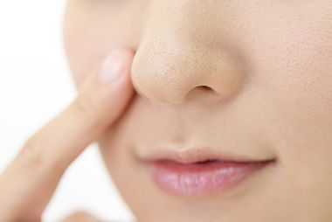
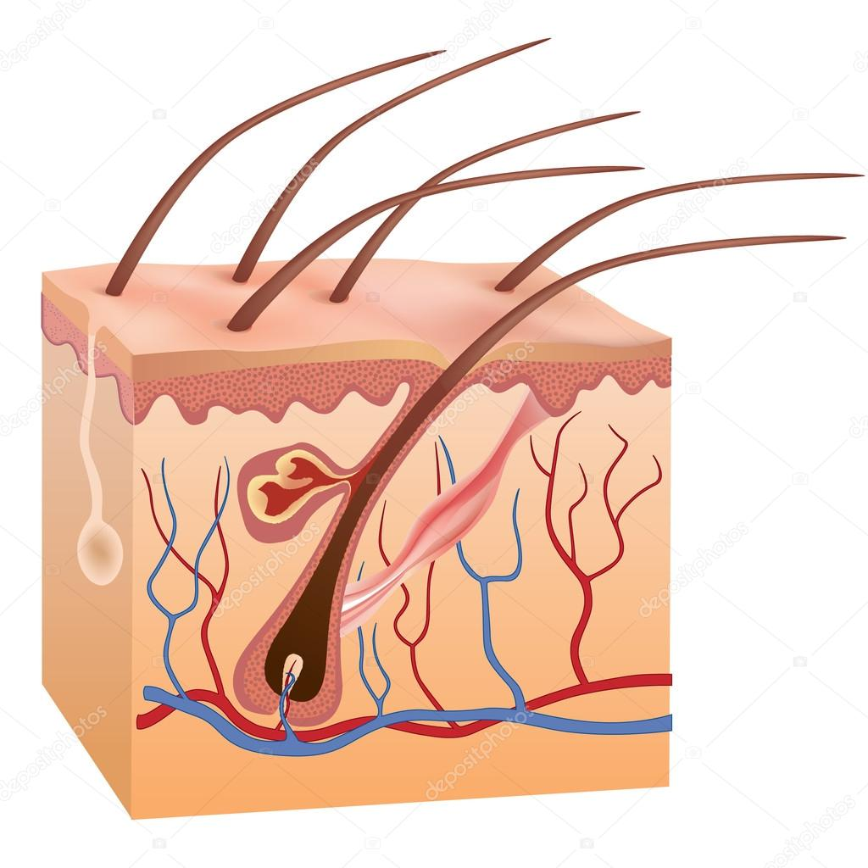
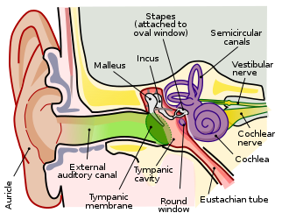
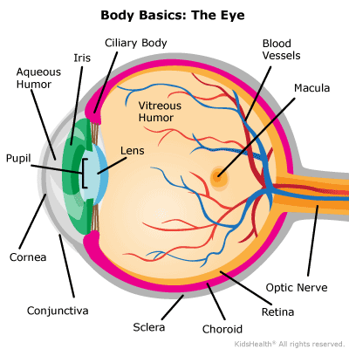
What organ corresponds to SIGHT?

Slide 2
What organ corresponds to TASTE?

Slide 3
What organ corresponds to SMELL?

Slide 4
What organ corresponds to HEARING?

Slide 5
What organ corresponds to TOUCH?

