Slide 1
UNIT 1 - INTERACTION
How does a cold affect your sense of taste?
Do parts of our brain control different things?
How do gymnastics bend backwards?
Unit review
What happens when you touch something hot?

Slide 2
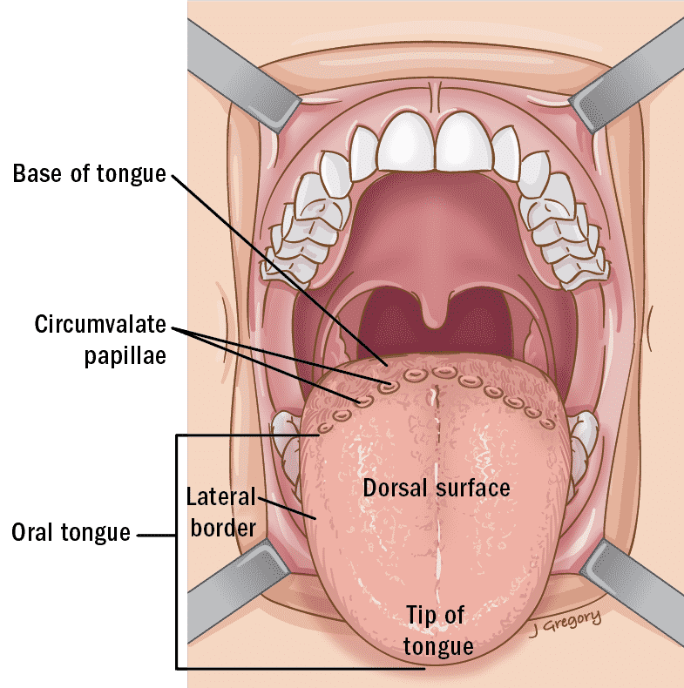
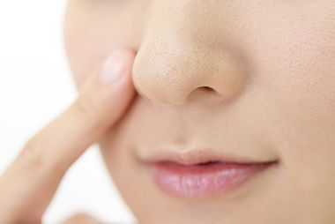
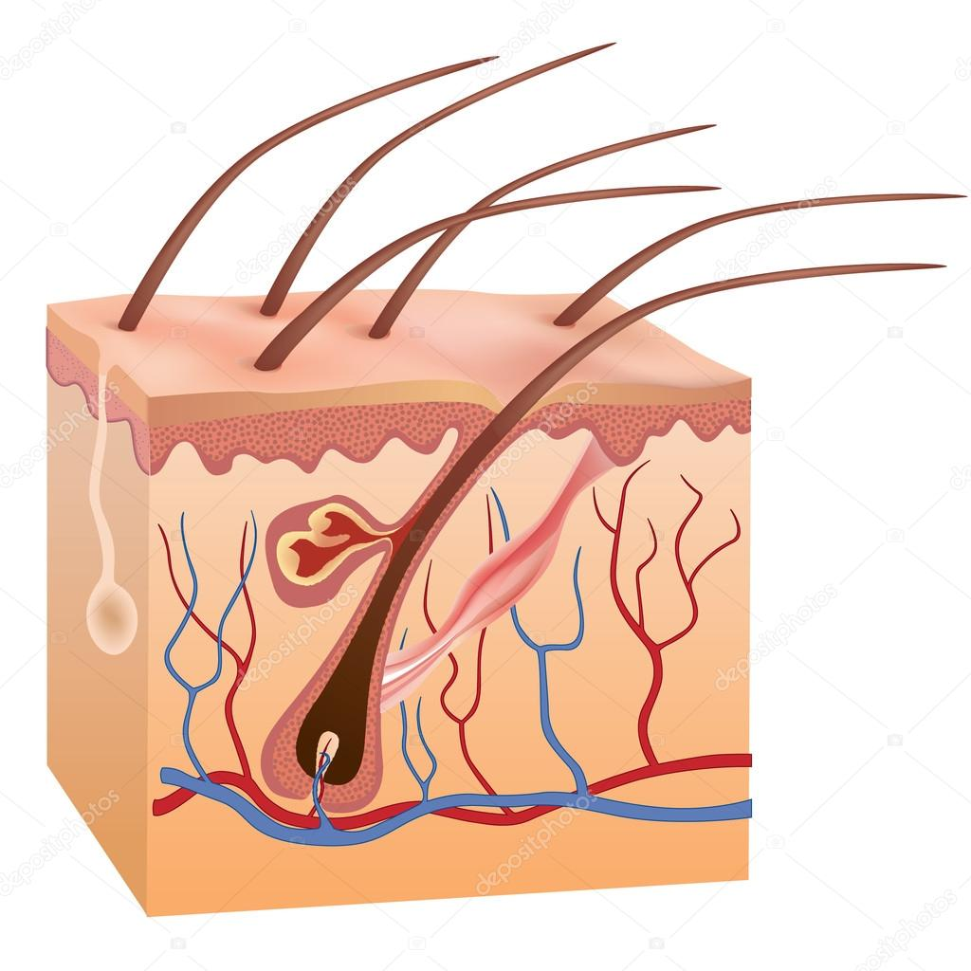
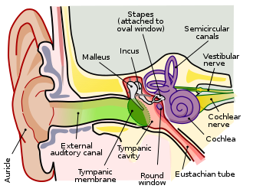
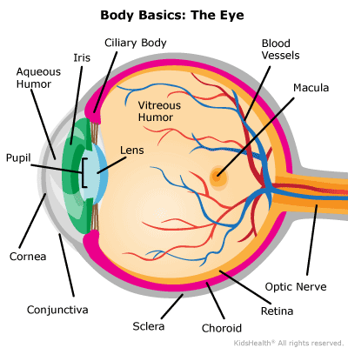
Which organ corresponds to SIGHT?

Slide 3
Which organ corresponds to TASTE?

Slide 4
Which organ corresponds to SMELL?

Slide 5
Which organ corresponds to HEARING?

Slide 6
Which organ corresponds to TOUCH?

Slide 7
Which are the parts of a NEURON?
Stem
Nerves
Brain
Axon
Dendrite
Spinal cord

