Slide 1
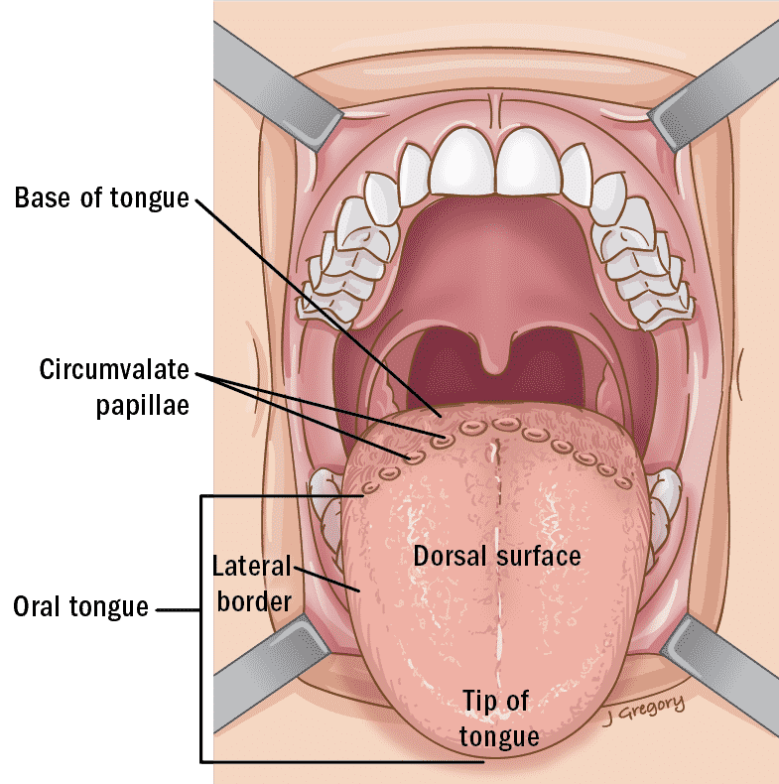
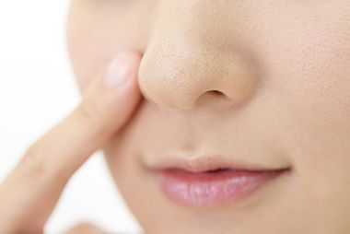
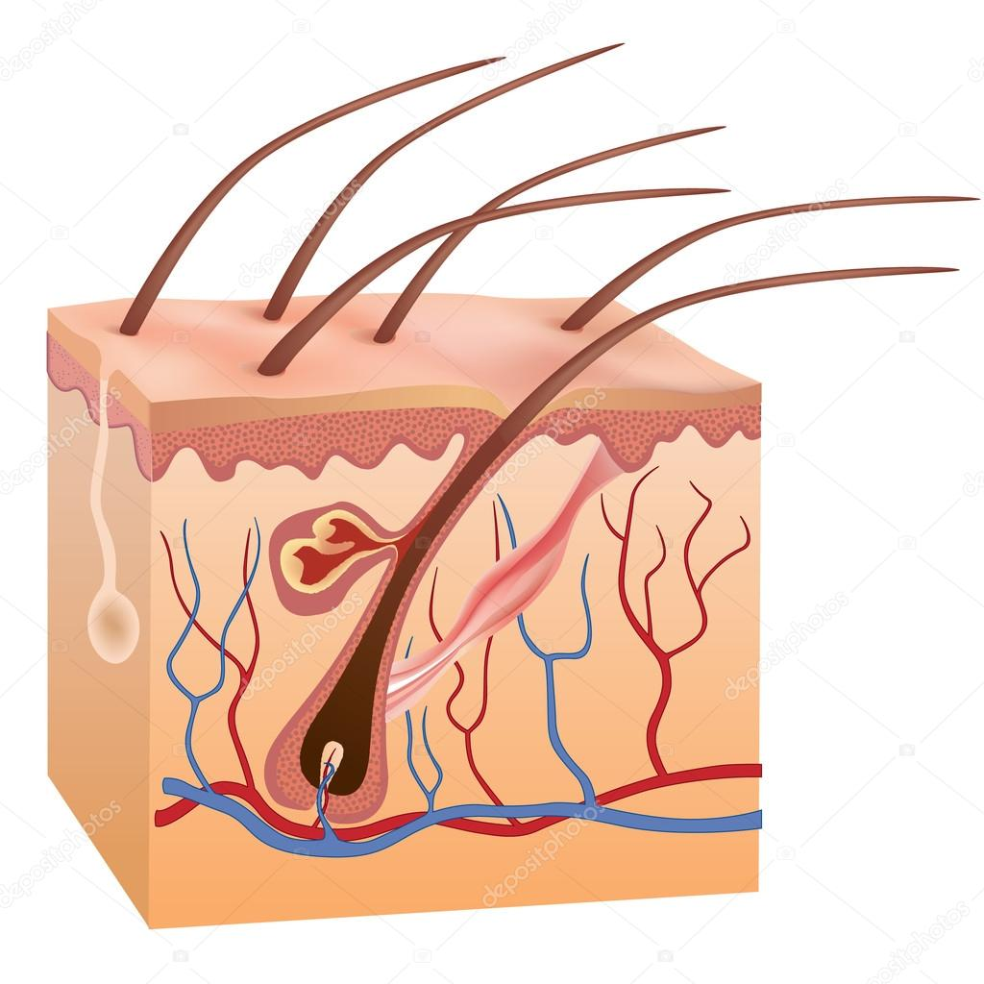
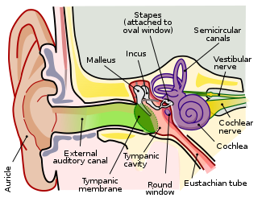
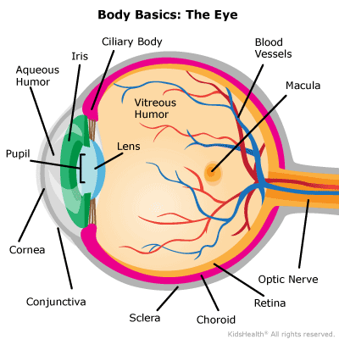
Which organ corresponds to SIGHT?

Slide 2
Which organ corresponds to TASTE?

Slide 3
Which organ corresponds to SMELL?

Slide 4
Which organ corresponds to HEARING?

Slide 5
Which organ corresponds to TOUCH?

