Slide 1
PRESENT SIMPLE
PAST SIMPLE
VOCABULARY

Slide 2
CHOOSE THE RIGHT VERBS ACCORDING THE SUBJECT IN 3RD PERSON
SPEAKS
EAT
ARE
WATCHES
HELP
PLAYS
DANCES
MUSIC
IMAGINES
LISTEN
CELLPHONE
WALK
DREAM
IS
STUDY
JUMP
BOOKS
KISSES
BOX

Slide 3
WRITE DOWN THE CORRECT VERB IN PAST SIMPLE
SHE_______________---------------------- _________ SOME SHOES YESTERDAY (BUY)
HE__________-------------------TO PANAMA WITH HIS FAMILY LAST YEAR (TRAVEL)
THEY___________---------------------FOR THE EXAM TOGETHER (STUDY)
SARAH------------------------ _________________ THE HAMBURGUER LAST NIGHT (NOT/EAT)
MICHAEL AND SUSANA________________-------------------- THE HOUSE IN MIAMI (NOT/LIKE)
I__________-----------------------------A SCHOLARSHIP IN LONDON (WIN)
CARMELIA______________---------------- IN MACDONALD’S UNTIL MIDNIGHT YESTERDAY (WORK)
¿----------------__________ THEY_________---------------- THE DOCUMENT FOR THE EXAM? (READ)
I-------------------- ___________ TO THE PARTY LAST SUNDAY (GO)
MIGUEL__________ WITH HIS PARENTS------------------------ LAST WEEK (SPEAK)

Slide 4
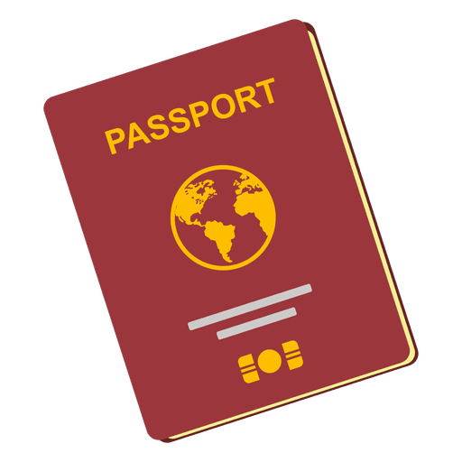
WIRTE THE DOWN THE NAME OF EACH IMAGE

