Slide 1
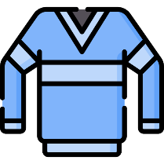
SCHOOL OBJECTS
TEACHER MELISA

Slide 2
Which one is book?

Slide 3
Which one is rubber?

Slide 4
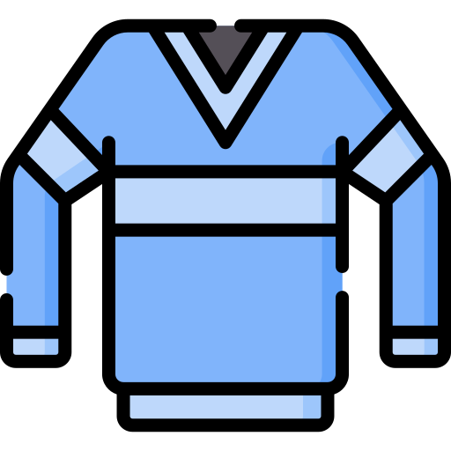
Which one is pencil?

Slide 5
Which one is jumper?

