Slide 1
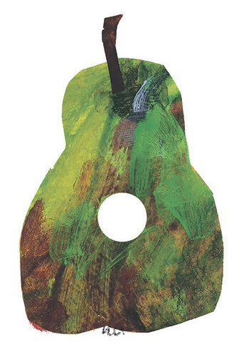
WHERE IS THE PEAR?

Slide 2
ON MONDAY HE DIDN’T EAT …

