Slide 1
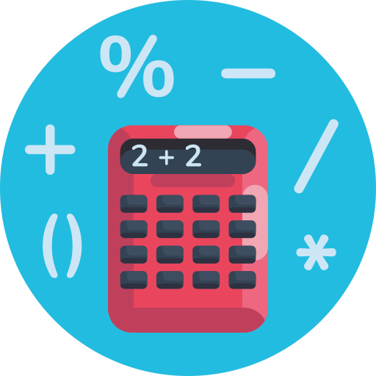
YOU LEARN ABOUT LIVING BEINGS AND THE HUMAN BODY
biology
Notes:
Icons made by <a href="https://www.flaticon.com/authors/dighital" title="Dighital">Dighital</a> from <a href="https://www.flaticon.com/" title="Flaticon"> www.flaticon.com</a>

Slide 2
YOU LEARN ABOUT WORDS AND HOW TO FORM SENTENCES
languages

Slide 3
YOU LEARN HOW TO DO ADDITIONS, SUBSTRACTIONS AND MULTIPLICATIONS
maths

Slide 4
YOU LEARN ABOUT COUNTRIES, RIVERS AND MOUNTAINS
geography

