Slide 1
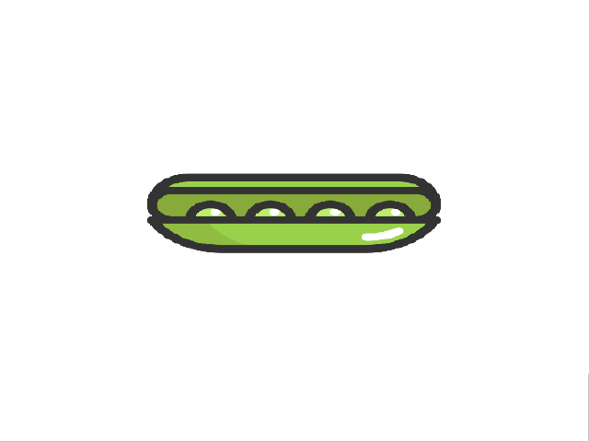
I like
i don’t like

