Slide 1
Wordwall
Speaking
Listening
DAILY
ROUTINES
Reading
Writing
Notes:
https://padlet.com/rosydiruvo/n9fz5lgc3s6k

Slide 2
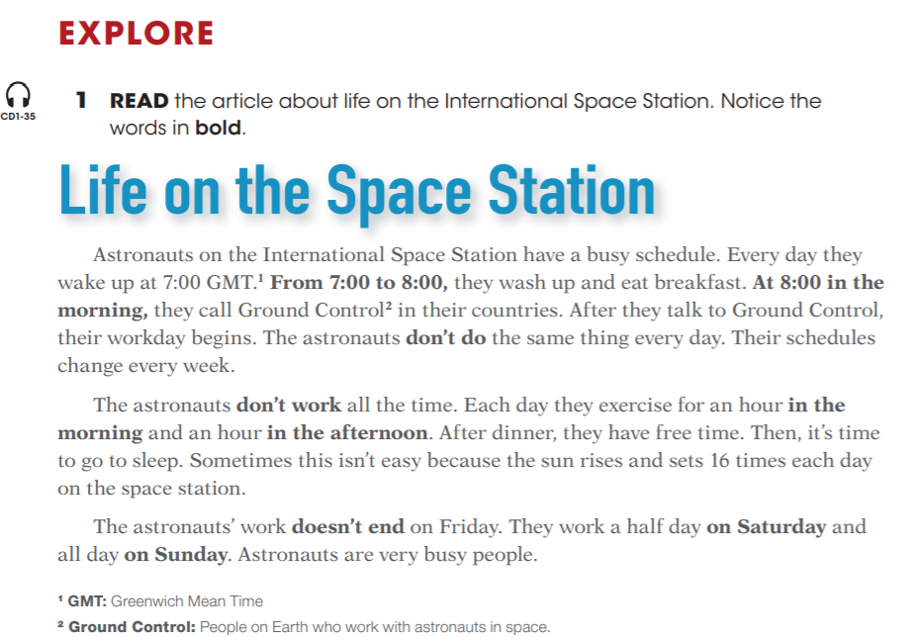
Reading
QUESTIONS

Slide 4
Writing

Slide 5
At what time do you wake up?
Do you often watch TV?
What do you do in the weekends?
At what time do you have breakfast?
Do you always brush your teeth?
Daily routines
At what time do you have lunch?
Do you usually do homework in the afternoon?
What do you normally do at 7pm?

