Slide 1
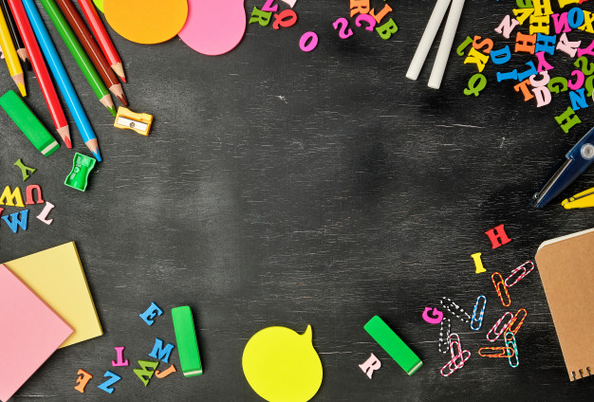
Pepe
Juanita
Pepe
Juanita
Pepe
Juanita
Pepe
Pepe
Juanita
Juanita
Pepe
Juanita
Pepe
Juanita
Mi profe
Pepe
Juanita
Pepe
Juanita
Pepe
Juanita
2º PRIMARIA - CURSO 2019 / 2020
María

